Slide 1
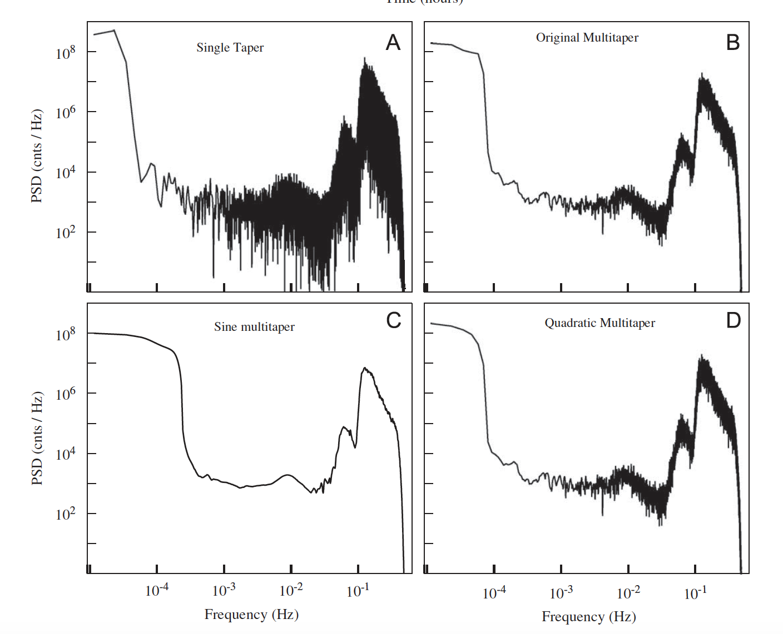
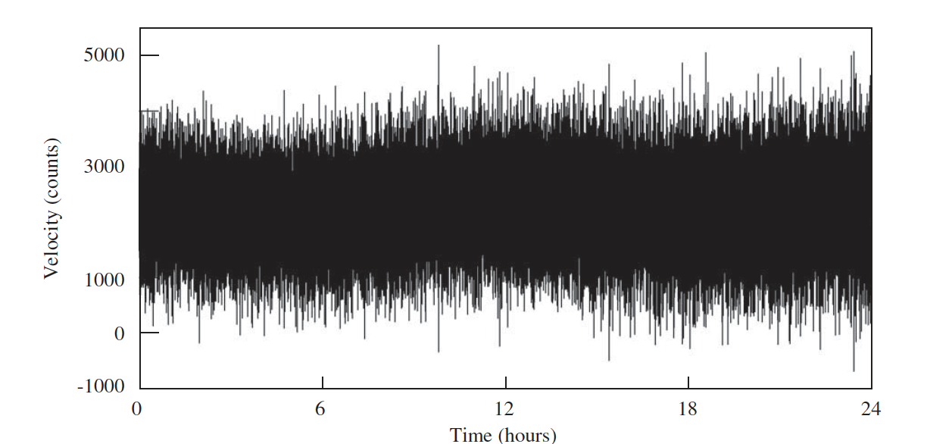
Time series and Fourier Analysis
Germán A. Prieto
Universidad Nacional de Colombia
ROSES

Slide 2
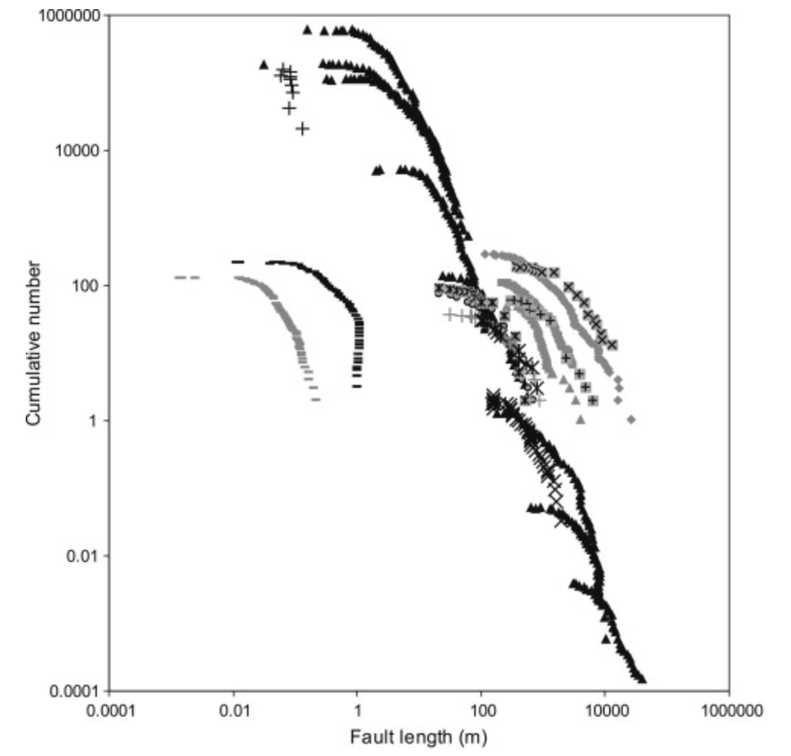
A dataset
In geophysics we use statistical methods to analyze data
A compilation of measured length distributions for faults and fractures
Scaling of fault attributes: A review
Torabi and Berg, 2011

Slide 3
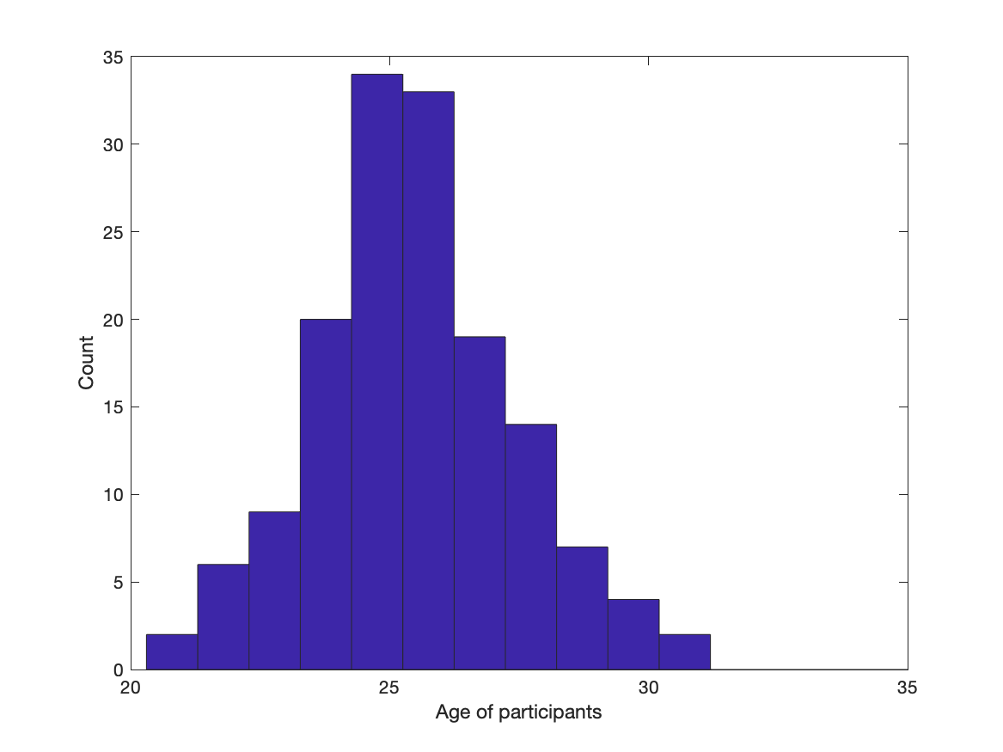
Another dataset
In geophysics we use statistical methods to analyze data
Ages (not real) of participants of ROSES.
With a few outliers

Slide 4
Two datasets
In geophysics we use statistical methods to analyze data
these observations have no special order associated with them.

Slide 5
Time series analysis
A sub-field of statistical estimation methods
it is a mature subject with extensive literature.
many times not mastered by geophysicist.

Slide 6
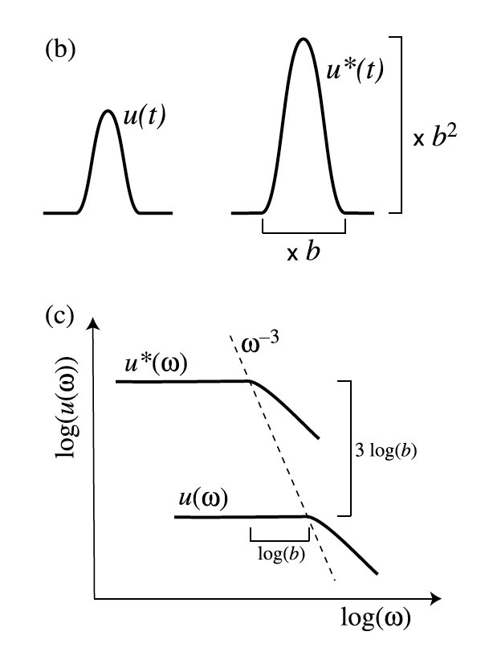
Time series analysis
A sub-field of statistical estimation methods
it is a mature subject with extensive literature.
many times not mastered by geophysicist.
Two (+) branches of time series analysis exist.
Methodologies applied in the time (space) domain.
Methodologies that employ the frequency (wavenumber) domain

Slide 7
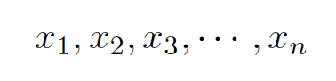
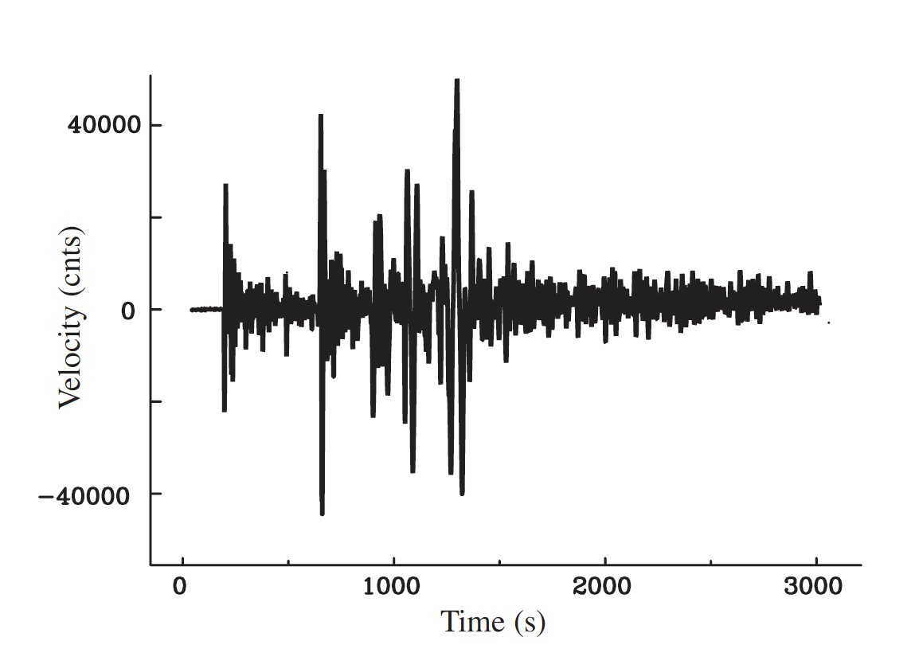
Time series analysis
We will study data in which the order is important
we will call the sequence
a time series, index n denotes the time t=nΔt.
In most cases, we will assume that data is sampled uniformly.
Sampling in space is similar.
PFO - September 26 2005 Peru M7.5 Earthquake

Slide 8
Random variables
Let’s get back to our initial example
Draw a person from the pool
From the ensemble of ROSES participants
x = 28 years

Slide 9
Random variables
Let’s get back to our initial example
Draw a person from the pool
From the ensemble of ROSES participants
x = 28 years
A second try
x = 24 years

Slide 10
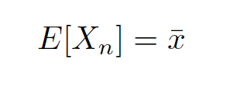
Random variables
Let’s get back to our initial example
Draw a person from the pool
From the ensemble of ROSES participants
x = 28 years
A second try
x = 24 years
The results of each experiment (the realization) is drawn from the Probability Density function (PDF) of the underlying process.
What is the expected value?

Slide 11
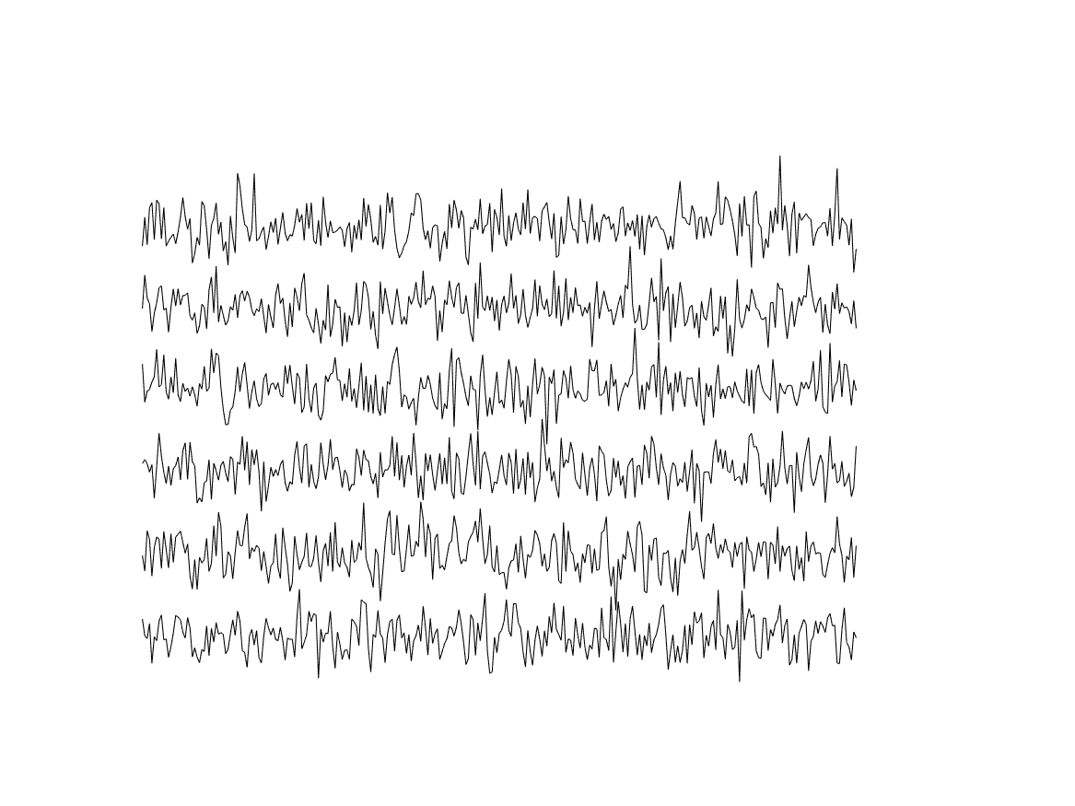
Time series analysis
We will study data in which the order is important
A given data series (x₁,x₂, …, x_{n}) is the result of an experiment that could be repeated as many times as we like.
Five realizations of the same stochastic process.

Slide 12
Time series analysis
We will study data in which the order is important
A given data series (x₁,x₂, …, x_{n}) is the result of an experiment that could be repeated as many times as we like.
We have just one realization, drawn from an ensemble of alternative series, all generated by the underlying process described by its PDF.
Five realizations of the same stochastic process.

Slide 13
Time series analysis
We will study data in which the order is important
What is the expected value E[X_{n}] at time point n?
When we think of operations such as taking the average or expected value at a particular n or t, in general this is an average over different realizations for the same n or t.
Five realizations of the same stochastic process.

Slide 14
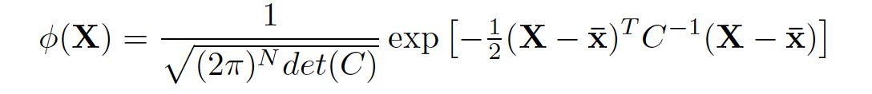
Time series analysis
We will study data in which the order is important
What is the expected value E[X_{n}] at time point n?
Given N data, the joint PDF is
C is the NxN covariance matrix, describing correlations between the random variables X_{n}. We would need N(N+3)/2 parameters.
Five realizations of the same stochastic process.

Slide 15
Time series analysis
We will study data in which the order is important
What is the expected value E[X_{n}] at time point n?
Given N data, the joint PDF is
C is the NxN covariance matrix, describing correlations between the random variables X_{n}. We would need N(N+3)/2 parameters.
Intractable
Five realizations of the same stochastic process.

Slide 16
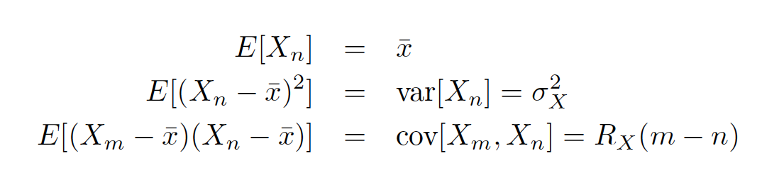
Stationary Processes
Focus on a more restrictive class of random processes, stationary processes
The idea here is that, while the actual observables vary in time, the underlying statistical description is time invariant.
None, dependent on n, R_{X} only on interval (m-n).
Sometimes we even try to make a time series look stationary (removing the trend for example).

Slide 17
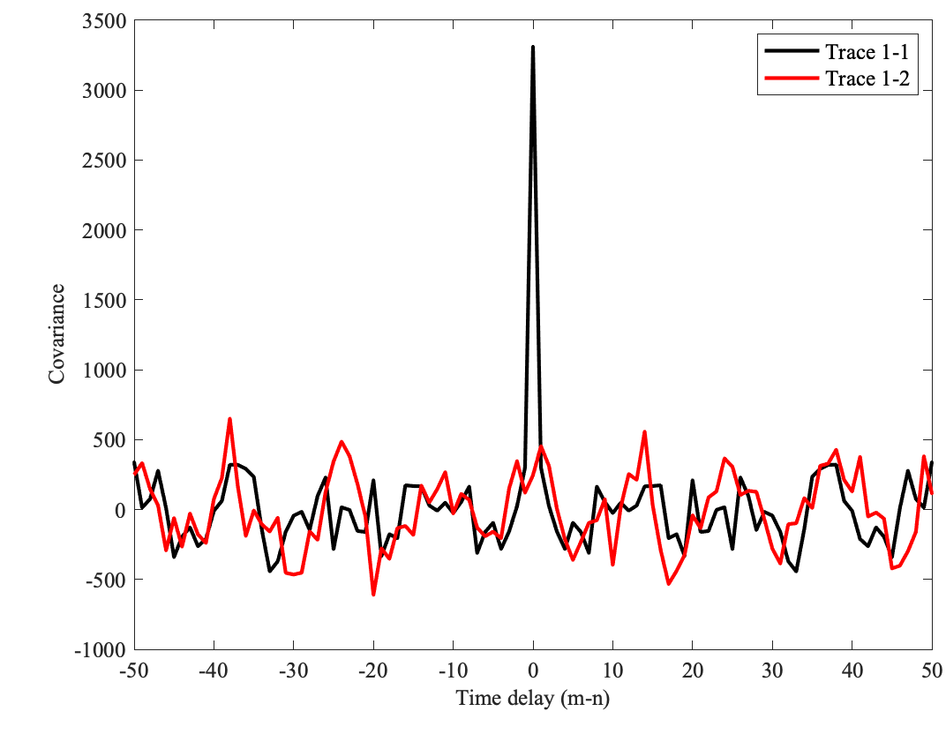
Stationary Processes
Focus on a more restrictive class of rand processes, stationary processes
Time series
Covariance
Just because the stochastic process is composed of random variables does not mean it is completely unpredictable.

Slide 18
Take-home Message 1
We will study data in which the order is important.
You get one realization of the stochastic process.
In order to describe it statistically, we need to make assumptions, stationary random processes.

Slide 19
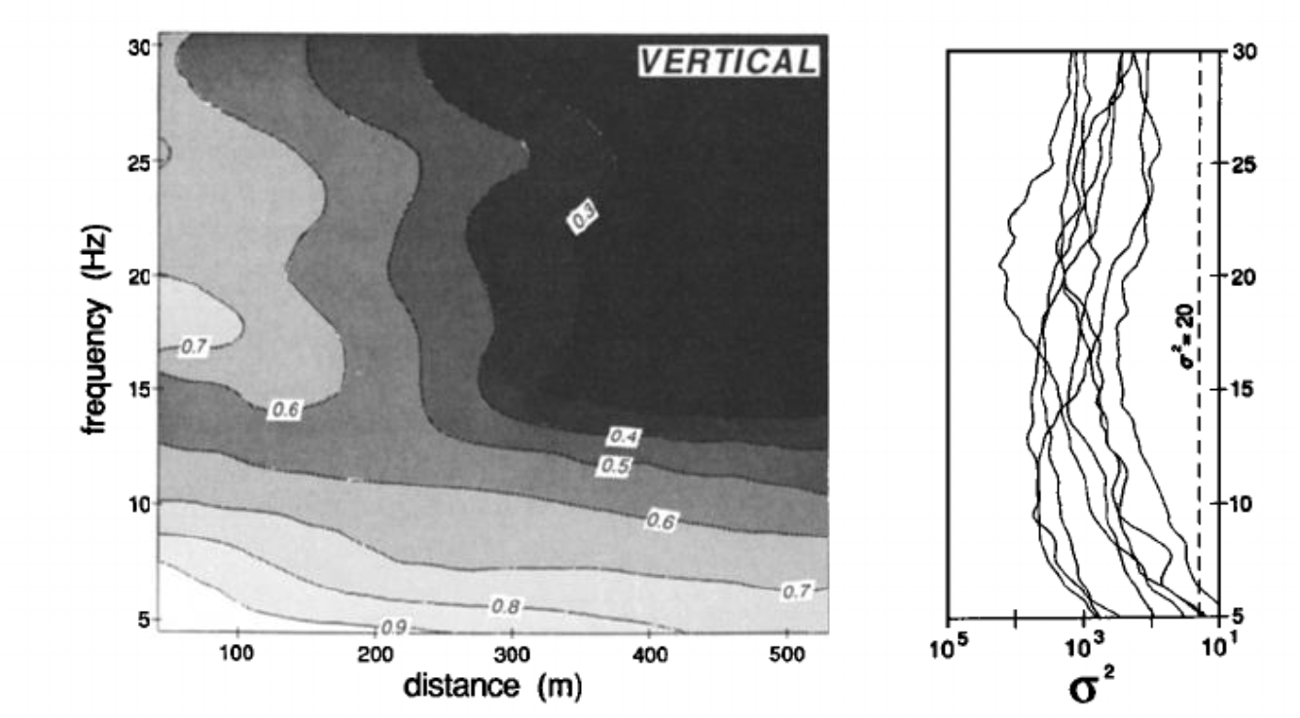
A quick tour on Fourier Theory
Most of these notes are drawn from when I was a student at Scripps. Thanks to Bob Parker, C. Constable, F. Vernon and many others.
We will discuss terms like the frequency domain or the wavenumber domain, the several meanings of the word spectrum, the idea of filtering or of coherence between two records. I hope most of you feel comfortable with them (and you should, if you are to be a seismologist).
Coherence of seismic body waves …
Vernon et al., 1991

Slide 20
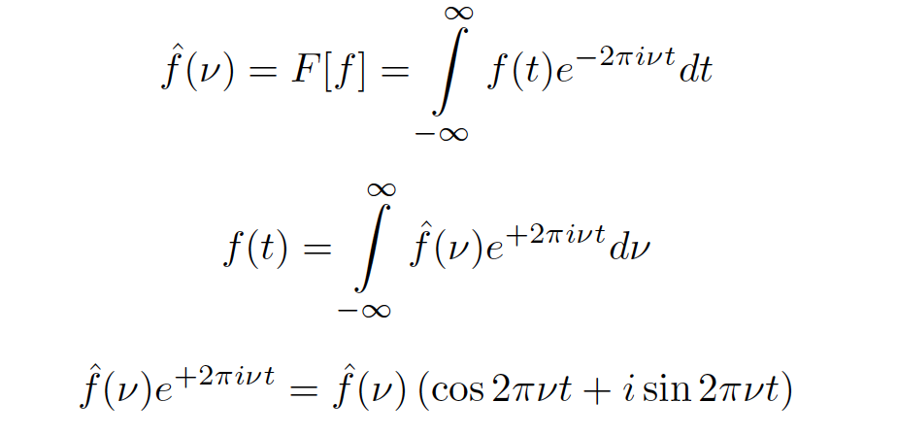
What is the Fourier transform?
For a suitable function of a single real variable the definition we will use is:
Fourier Transform
This operation takes a real function and generates from it another complex-valued function (w.r.t. ν). It is a kind of linear mapping.
What does the transform mean?

Slide 21
What is the Fourier transform?
For a suitable function of a single real variable the definition we will use is:
Imagine building up the function f from (an infinite) sum of sines and cosines (not every function can be built like this, but many can)
Inverse
Fourier Transform
You can see this function is a sine wave, but it has real and imaginary parts.
Function f(t) repeats itself, with a period of 1/ν.

Slide 22
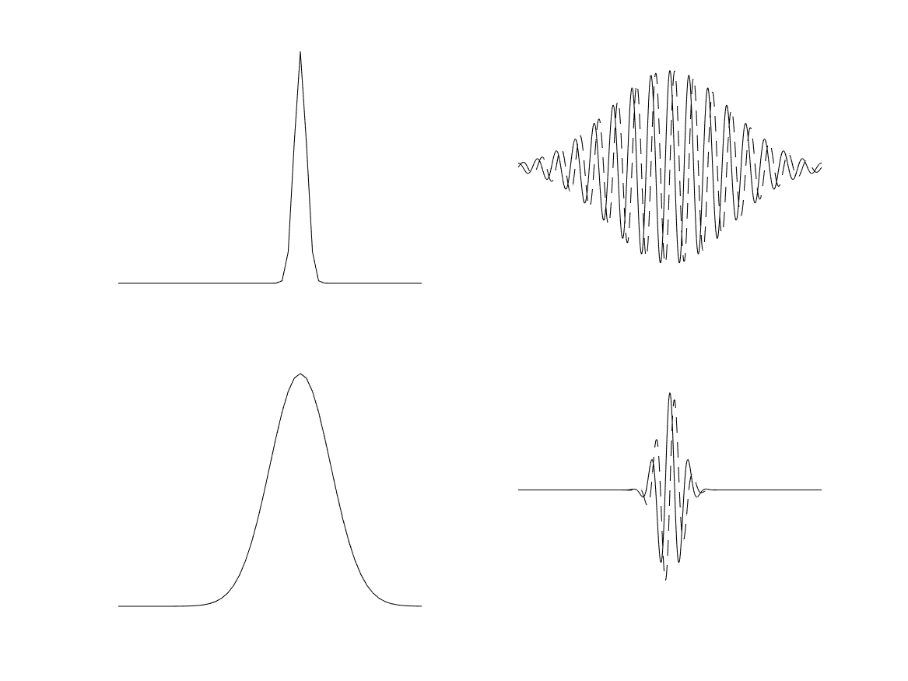
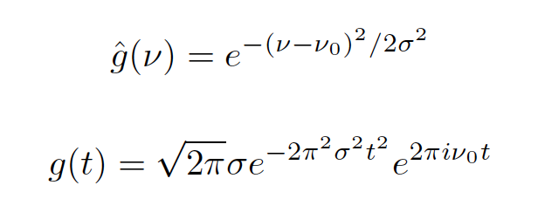
What is the Fourier transform?
If f(ν) is non-zero at ν₀, the corresponding f(t) is just a sine function.
Example:
ν=ν₀

Slide 23
What is the Fourier transform?
If f(ν) is non-zero at ν₀, the corresponding f(t) is just a sine function.
Example:
ν=ν₀
1/ν₀

Slide 24
What is the Fourier transform?
If f(ν) is non-zero at ν₀, the corresponding f(t) is just a sine function.
Example:
ν=ν₀
ν=ν₀
FT Pairs 1: The FT of a Gaussian, is a Guassian.

Slide 25
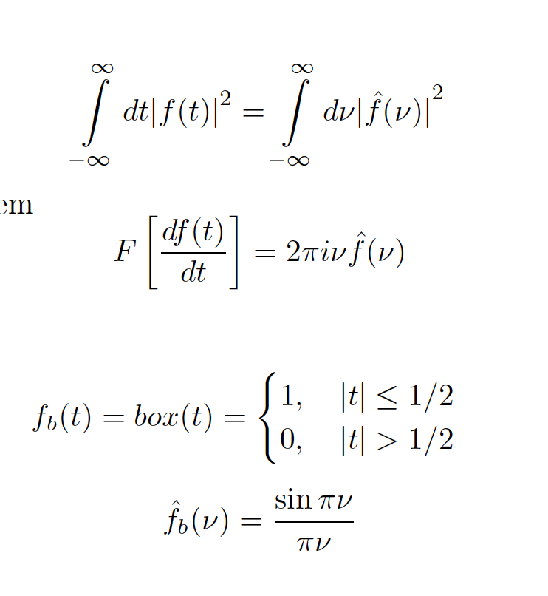
FT Theorems
Parseval’s or Power Theorem
Derivative Theorem

Slide 26
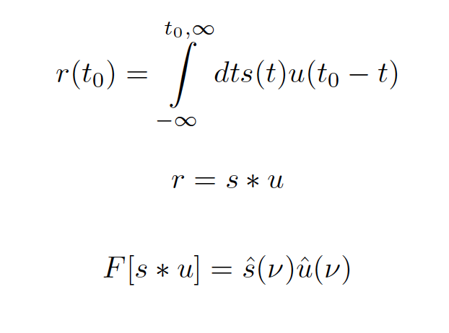
Convolution
Imagine a seismometer, whose impulse response is u(t), which means that an input pulse of unit height and short duration dt generates output of the form u(t) dt.
What happens when a continuous signal s(t) in the ground excites the seismometer. The output at a particular time t₀ is the sum (really the integral) of all the contributions from the impulse responses at all previous times.
Instruments can’t predict the future (causal), so the integral is to infinity.
The integral above is called a convolution and is often written

Slide 27
FT Theorems
Parseval’s or Power Theorem
Derivative Theorem
Convolution Theorem

Slide 28
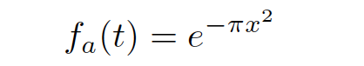
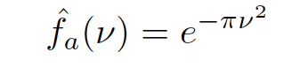
FT Pairs
Gaussian - Gaussian
Box Car - sinc

Slide 29
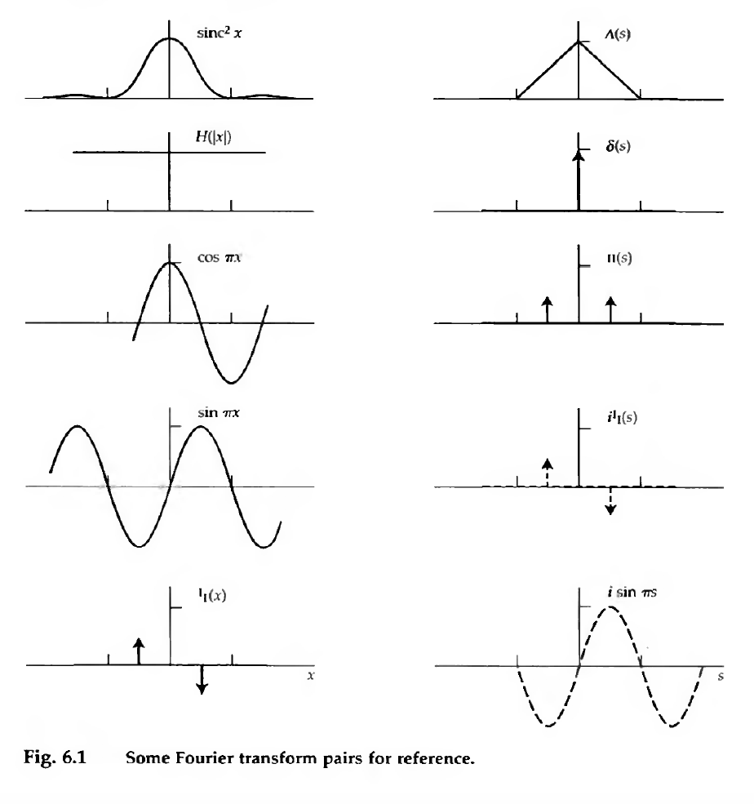
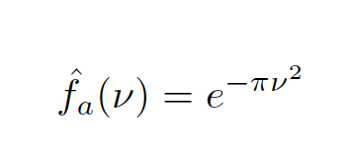
FT Pairs

Slide 30
Take-home Message 1
Fourier transform and its inverse. Linear mapping.
Narrow signal in one domain, broad signal in the other. Uncertainty principle, you can’t have both infinite time and frequency resolution.
Remember (and prove) some theorems and pairs.

Slide 31
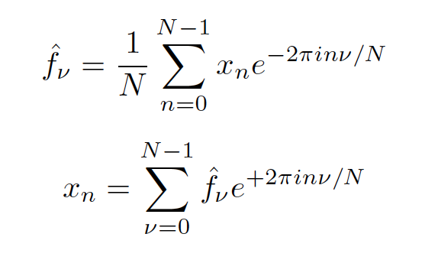
The Discrete Fourier Transform DFT
In real life, we have three problems.
Computers don’t like doing integrals (they do sums).
Our data is digitized, discretely sampled, so not continuous.
Our data is finite length.
DFT
Inverse DFT

Slide 32
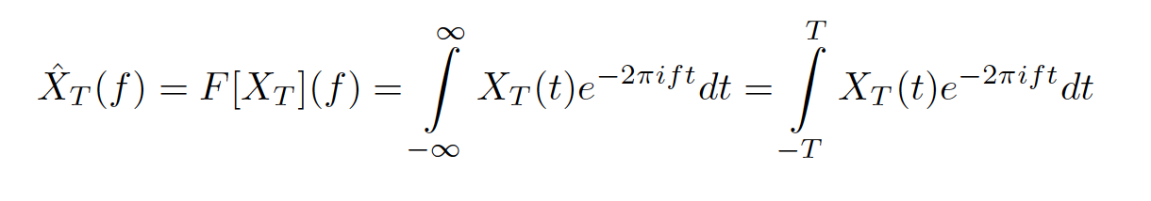
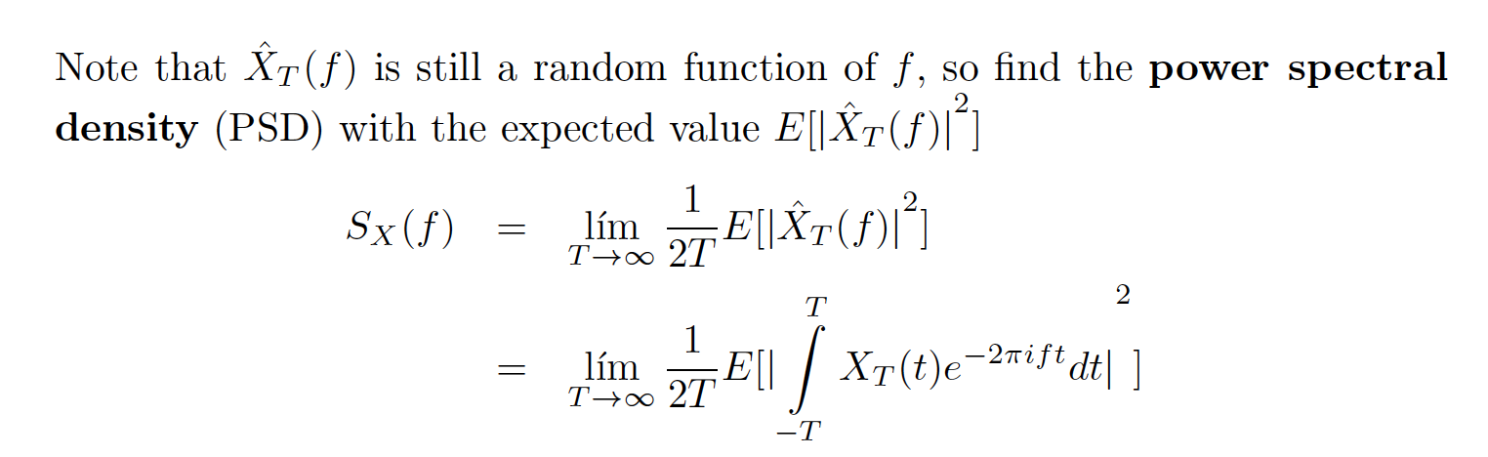
The DFT in practice
Our input data, is a stationary random process X(t), and is finite in length.
The FT of X(t) would be a random process, not a statistic of X(t).

Slide 33
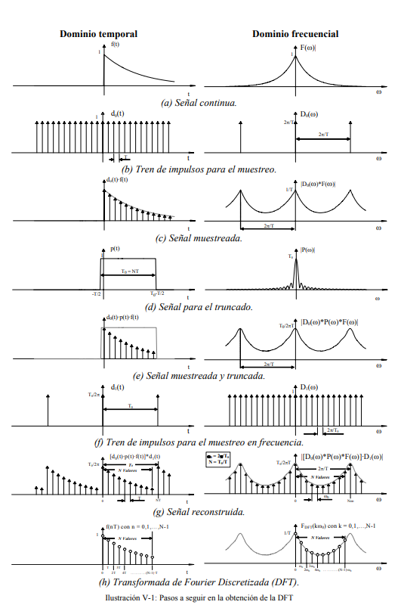
The DFT in practice
Our input data, is finite in length and discretely sampled.
Remember multiplication in one domain is convolution in the other.
Start with a continuous T and F domains
Sample discretely in T.
Effect on F of discrete sampling.
Cut signal between T=0-T_{max}

Slide 34
The DFT in practice
Our input data, is a stationary random process X(t),
and is finite in length and discretely sampled.
F domains convolved with sinc
Spectral leakage
Sample discretely in F.
Effect on T of F sampling.
Final. The DFT is not the FT.

Slide 35
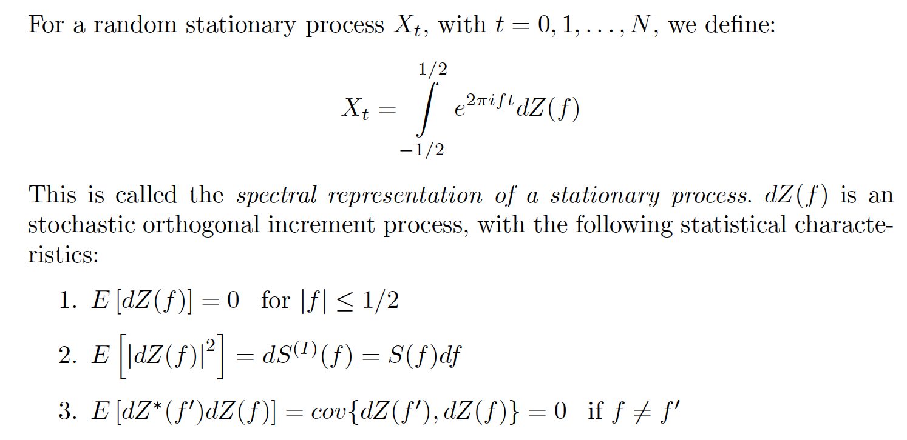
The DFT in practice
Draw a person from the pool

Slide 36
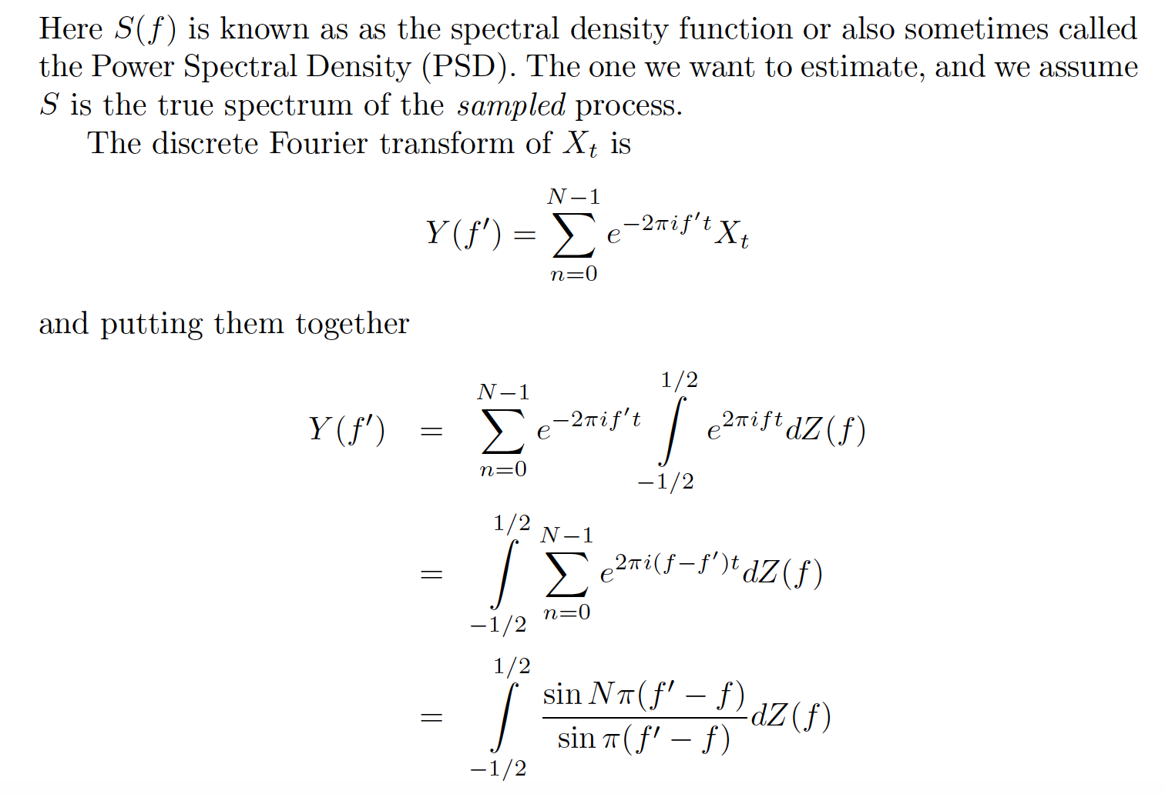
Spectral leakage
Draw a person from the pool

Slide 37
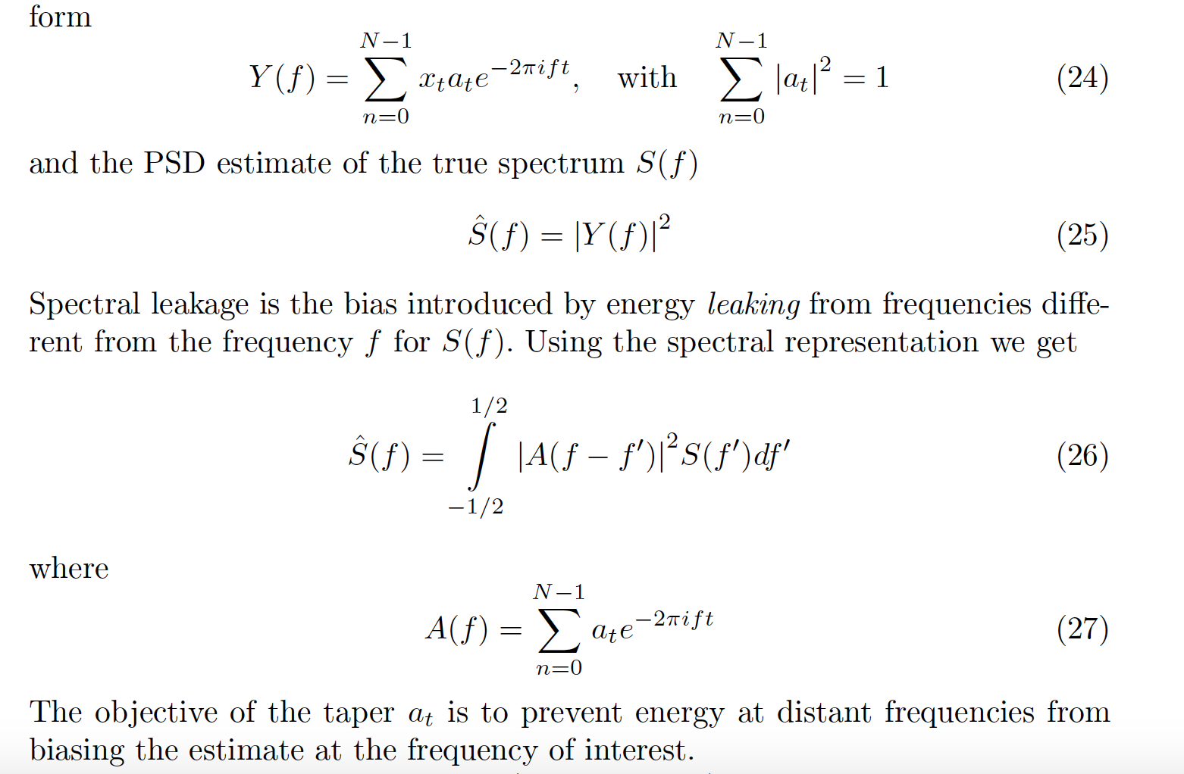
Spectral leakage - Direct spectral estimates

Slide 38
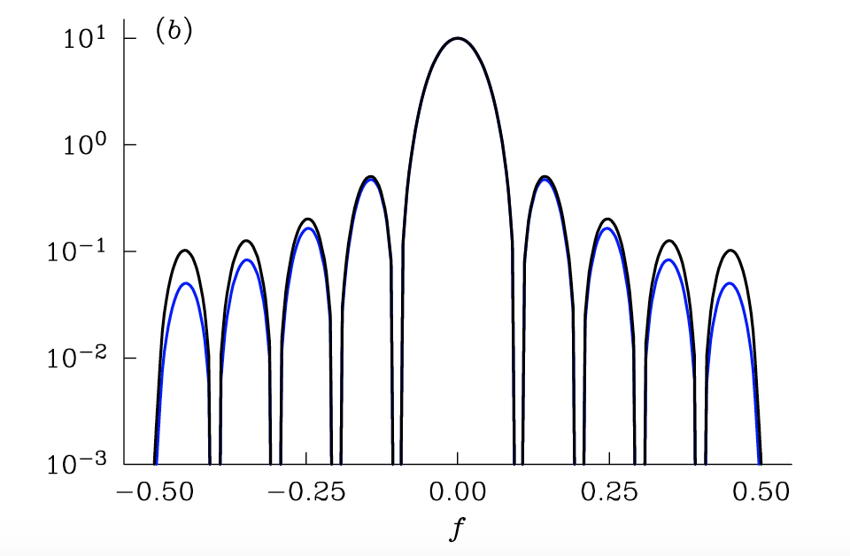
Spectral leakage
Equation 26 shows that simply using the DFT squared (the periodogram) as an estimator convolves the true spectrum with a function resembling sinc-squared, a function with considerable amplitude away from the central peak.

Slide 39
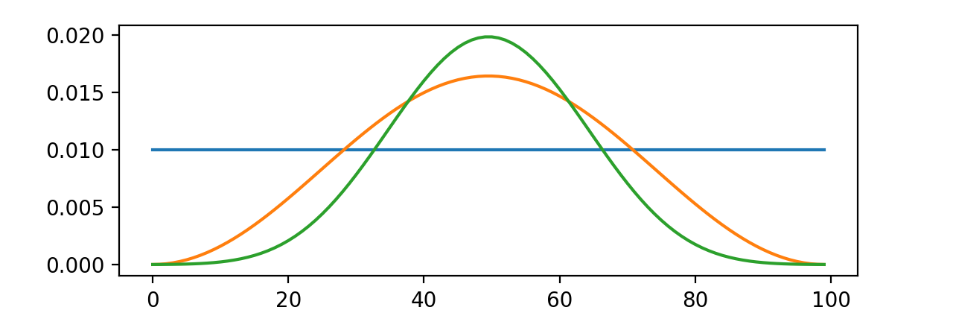
Spectral leakage in real life
a_{t}
N=100
Box-car (no taper). Hanning taper. Prolate taper (v₀)

Slide 40
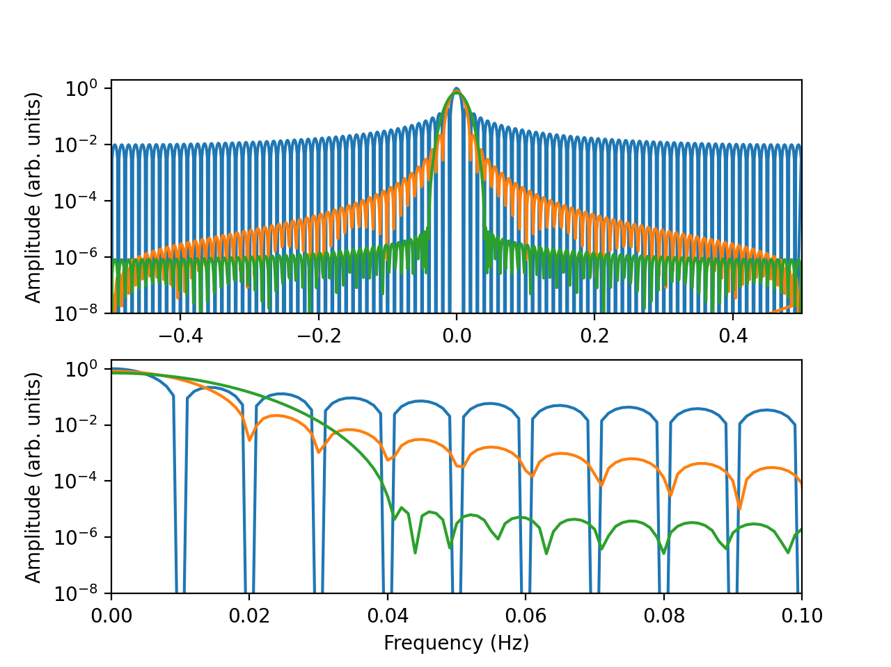
Spectral leakage in real life
|A(f)|
N=100
|A(f)|
Box-car (no taper). Hanning taper. Prolate taper (v₀)

Slide 41
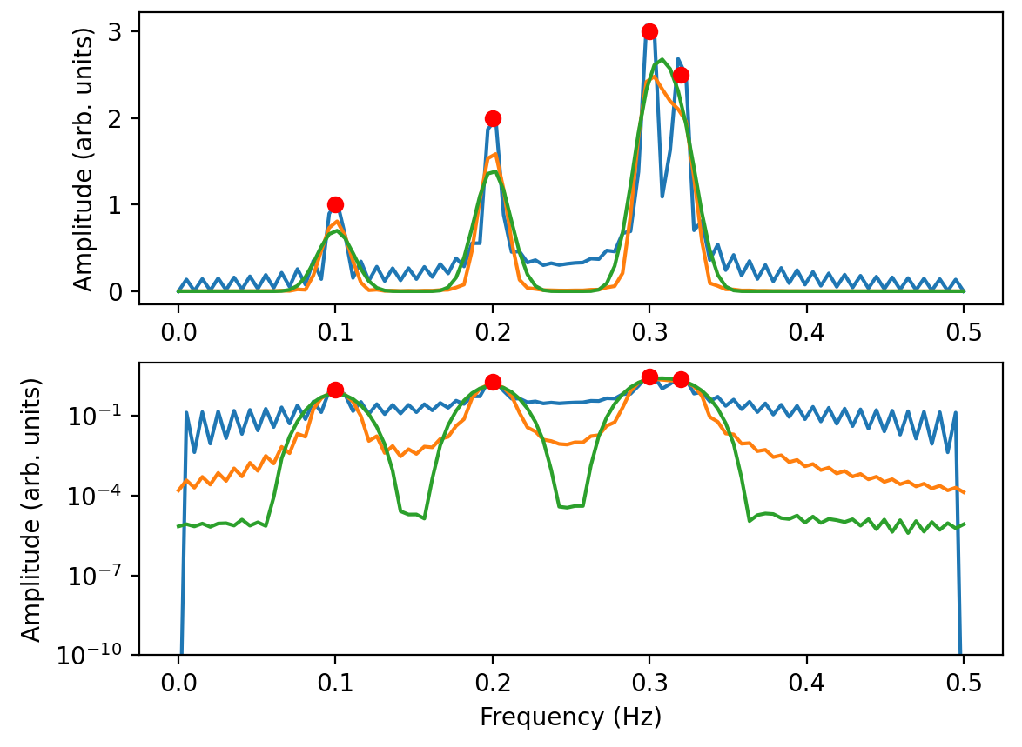
Spectral leakage in real life
Box-car (no taper). Hanning taper. Prolate taper (v₀)

Slide 42
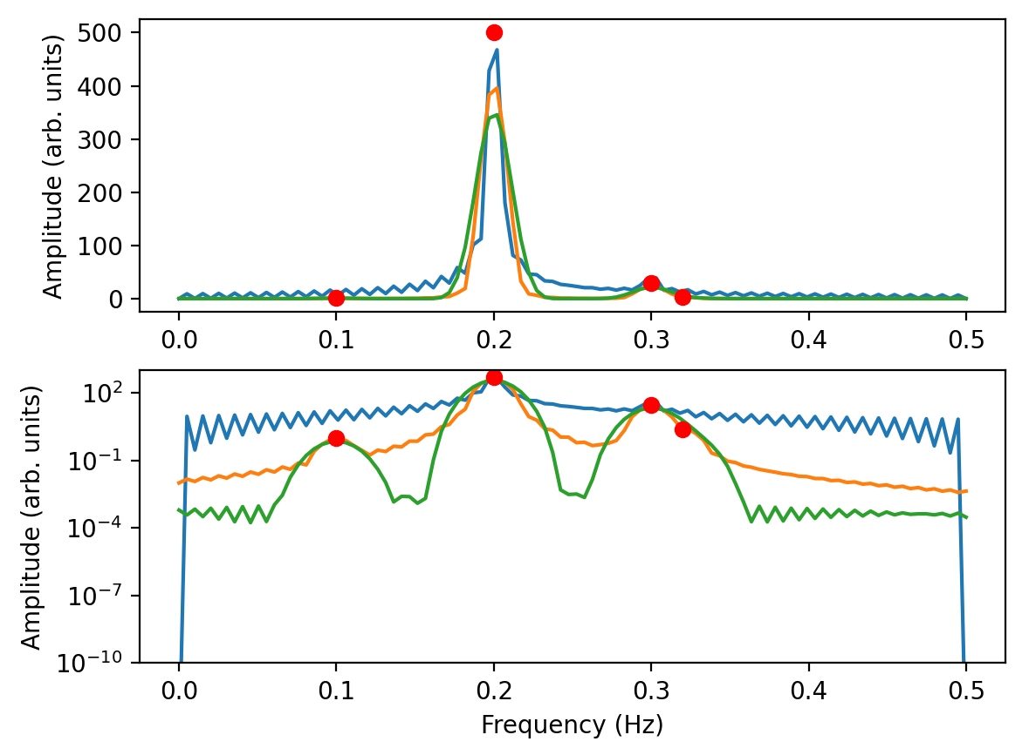
Spectral leakage in real life
Box-car (no taper). Hanning taper. Prolate taper (v₀)

Slide 43
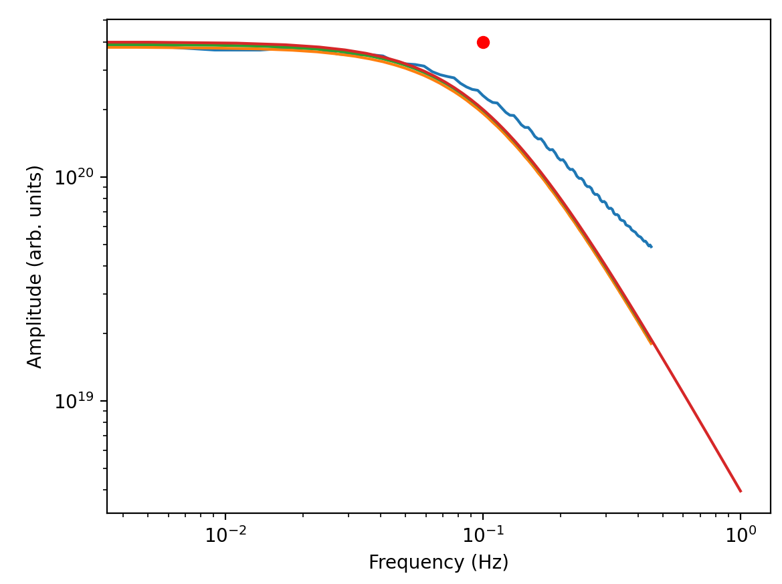
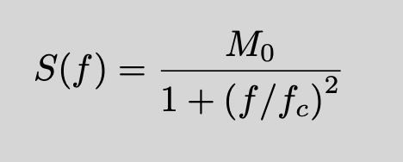
Spectral leakage – Earthquake source
In earthquake source
analysis, we estimate the
source spectrum, to find
Seismic Moment
Corner frequency
Stress Drop
Radiated Energy
…
Periodogram
True spectrum
Box-car (no taper). Hanning taper. Prolate taper (v₀)

Slide 44
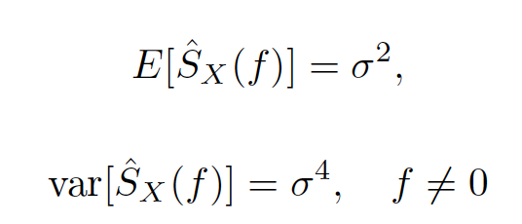
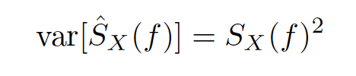
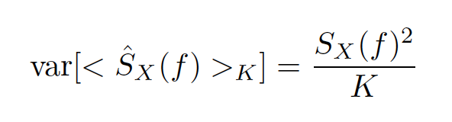
Moments of the PSD
By using the DFT (and the appropriate frequencies), for a white gaussian noise X_{n}, with zero mean and variance σ²
For spectra of other processes (colored-spectra), the periodogram is biased, and has variance
The periodogram has the virtue that the spectral estimates at the frequencies mΔt are uncorrelated for white noise, and this remains approximately true even for other smooth spectra. Therefore when we average K consecutive spectral estimates together

Slide 45
Take-home Message 3
Because the time series is finite and discretely sampled, the DFT is not equal to the FT.
The direct estimate of the PSD is
biased, convolution with taper response.
always use a taper
variance proportional to power. Needs averaging.
Average over frequencies (mov. Average)
multitaper methods

Slide 46
Practice Laboratory
How to get the DFT (uses FFT).
What the output means
Some examples
To do on your own
Get spectra of some seismic signals
Calculate the cross-spectra, correlation function and correlation coefficient using FFT
Perform deconvolution
Study earthquake source spectra

Slide 47
Questions so far?
Thank you

